Slide 1
Employee Data Analysis using Excel
STUDENT NAME: Sanjai.R
REGISTER NO: 9344394707
DEPARTMENT: B.COM ACCOUNTING AND FINANCE
COLLEGE: Avichi College of Arts and Science

Slide 2
PROJECT TITLE
Employee Performance Based On Job Level and Life balance Analysis.

Slide 3


AGENDA
Problem Statement
Project Overview
End Users
Our Solution and Proposition
Dataset Description
Modelling Approach
Results and Discussion
Conclusion
3/21/2024 Annual Review

Slide 4

PROBLEM
STATEMENT
The Employee performance may decline as job levels increase due to higher stress and poor work-life balance. Lower levels often have better balance and higher performance. Understanding the impact of job level on work-life balance is key to improving performance. Strategies should focus on enhancing productivity while maintaining employee well-being.

Slide 5

PROJECT OVERVIEW
This project aims to analyse the relationship between employee performance, job level, and work-life balance. It explores how higher job levels, often associated with greater responsibilities, may impact work-life balance and, in turn, affect performance.

Slide 6

WHO ARE THE END USERS?
HUMAN RESOURCE DEPARTMENTS
MANAGEMENT AND LEADERSHIP
TEAM LEADERS AND SUPERVISORS
EMPLOYEES
EXECUTIVE LEADERSHIP
BUSINESS ANALYSTS
RECRUITERS

Slide 7

OUR SOLUTION AND ITS VALUE PROPOSITION
FILTERING-
REMOVE VALUES
PIVOT TABLE -
SUMMARY OF EMPLOYEE
PERFORMANCE
FLOW CHART -
FINAL REPORT

Slide 8
Dataset Description
EMPLOYEE DATA SET- NAN MUDHALVAN PORTAL
9 FEATURES IN EXCEL:
EMPLOYEE ID- 967726447333
AGE- 19
GENDER- MALE
JOB ROLE - ACCMONTHLY INCOME - NUMERICAL
JOB SATISFACTION-ALPHABETICAL(TEXT)
EDUCATION LEVEL-ALPHABETICAL(TEXT)
MARITAL TYPE- ALPHABETICAL(TEXT)
OPPORTUNITIES- ALPHABETICAL(TEXT)
3 FEATURES USED:
DEPARTMENT - ALPHABETICAL(TEXT)
EMPLOYEE TYPE- ALPHABETICAL(TEXT)

Slide 9

THE "WOW" IN OUR SOLUTION
Tailored solutions for each job level to enhance performance while maintaining a healthy work-life balance. Offering fexibility in work schedules to reduce stress and improve productivity across all levels.
Using advanced analytics to provide actionable insights for sustainable performance and employee well-being.
3/21/2024 Annual Re
view
9

Slide 10
MODELLING
STEP -1
DOWNLOAD THE EMPLOYEE DATASET AND OPEN THE EMPLOYEE DATASET IN EXCEL.
STEP -2
SELECT THE ENTIRE DATA AND CLICK ON DATA AND CLICK ON FILTER OPTION.
STEP -3
FILTER FTP FROM A TO Z ORDER.
STEP -4 SELECT THE ENTIRE DATA AND CLICK ON INSERT AND CLICK ON PIVOT TABLE TO CREATE PIVOT TABLE.
10

Slide 11
STEP -5
DRAG THE NEEDED DATA AND CREATE A PIVOT TABLE.
STEP -6
SELECT THE PIVOT TABLE AND CLICK ON INSERT.
STEP-7
NOW CLICK ON THE CHART THAT YOU WANT.
STEP -8
THE CHART IS CREATED.

Slide 12
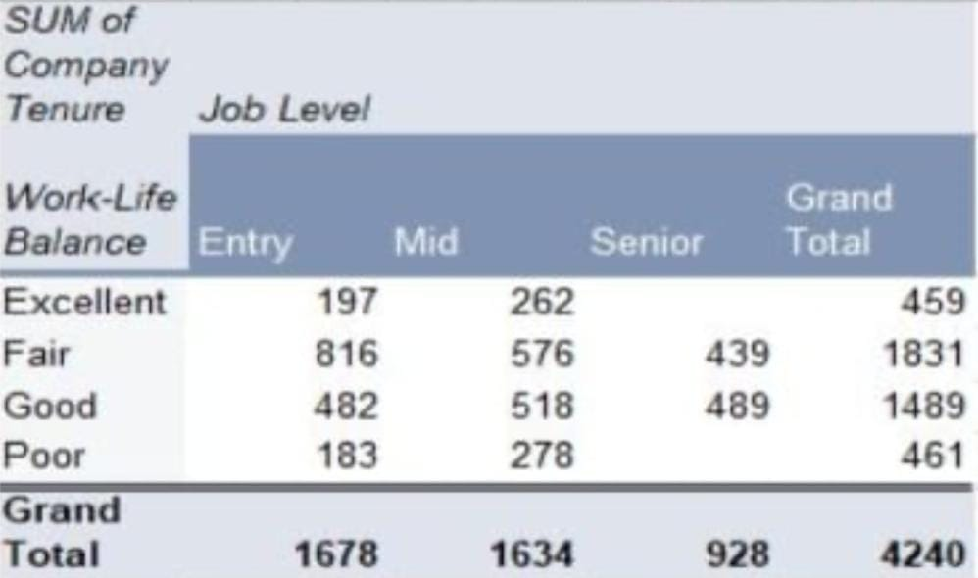
RESULTS
1.TABLE
12

Slide 13
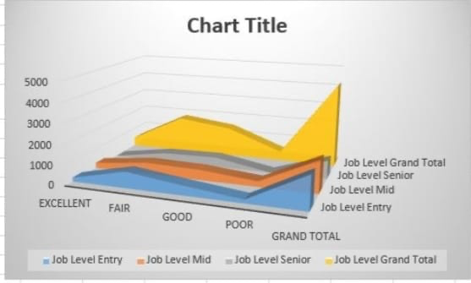
2. FLOW CHART

Slide 14
conclusion
The analysis reveals a significant relationship between job level, work-life balance, and employee performance.
Higher job levels often lead to increased stress and reduced work-life balance, negatively impacting performance. Conversely, employees who maintain a better work-life balance generally perform better.
Implementing flexible policies and providing resources to manage responsibilities effectively can lead to more sustainable performance outcomes.

